Slide 1

HANDWRITTEN DIGIT RECOGNITION
Final Project Review | Department of Computer Science and Engineering | KLH University
TEAM MEMBERS
2420030784 – HASINI PEDDI
2420030774 – KEERTHI
[2420030550 – GREESHMA SAI
Guide: Dr.N.Sunanda
Associate Professor
Department of CSE| Academic Year: 2026–2027
Notes:
Title slide. Replace all bracketed text. Use the full project title, list every team member with registration number, and name your guide. Insert the institution logo in the dashed box.

Slide 2
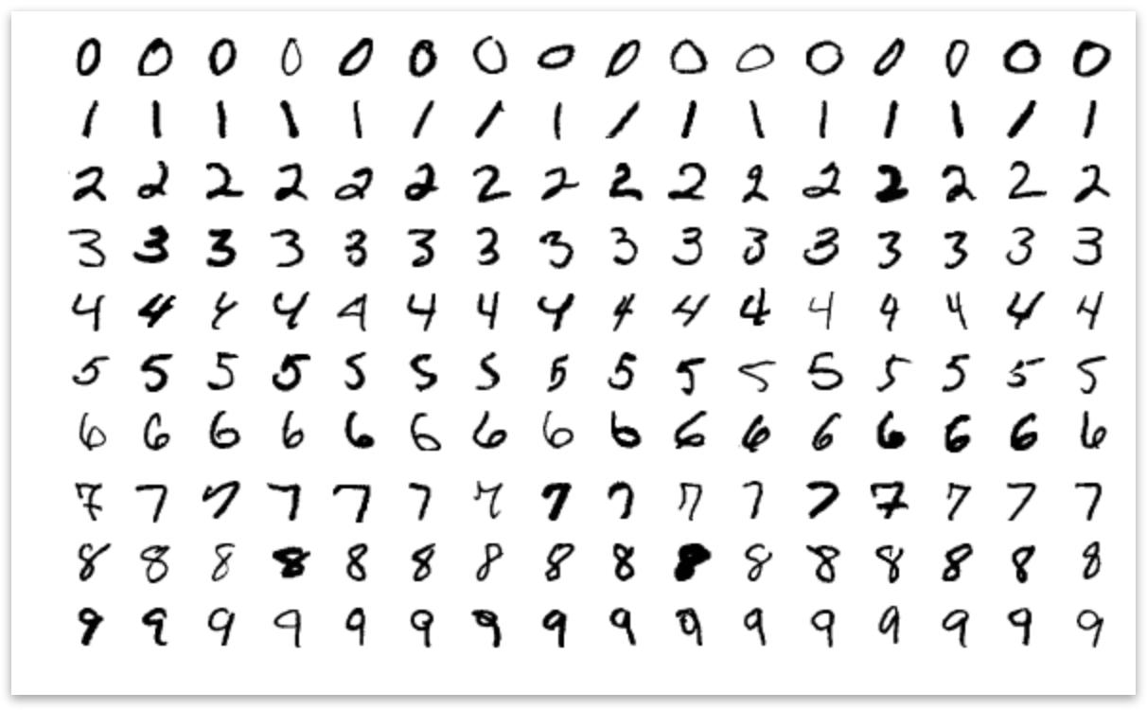



Introduction & Problem Statement
[Insert domain image, real-world scenario or problem illustration]
Background
Handwriting is one of the most common ways people communicate numbers. However, computers cannot understand handwritten digits directly like humans do.
Problem Statement
Recognizing handwritten digits accurately is difficult because their shapes, sizes, writing styles and positions can vary.
Motivation / Need
Reduce manual work involved in reading handwritten numbers.
Make handwritten digit recognition faster and easier.
Notes:
State the domain, the exact problem and why it matters. Keep it to about 2 minutes. Add one real-world statistic if you can, with a citation.

Slide 3


Objectives & Scope
Objectives
1
To develop a machine learning application that recognizes handwritten digits from 0 to 9.
2
To train and test KNN and SVM models using the MNIST dataset.
3
To compare both algorithms based on accuracy, precision, recall and F1-score.
4
To build an interactive application that supports digit drawing, image uploading and real-time prediction.
Notes:
Objectives should be measurable and start with action verbs. The scope slide tells the panel what you did and did not attempt.

Slide 4

Literature Survey
S.No | Author(s) & Year | Method / Technique | Key Findings | Limitation / Gap
1 | Chunmei Zhang et al, (2026) | ResNet18, deep feature extraction, MNIST and other datasets | Automatic feature extraction improves recognition and robustness to noisy data. | Requires lightweight model optimization and testing on more challenging datasets.
2 | Lei Guo & Zihan Wang, (2026) | Task-fMRI-derived brain topology constrained spiking neural networks | Reported 97.27% accuracy on MNIST and explored brain-inspired digit recognition. | Uses a fixed topology-to-network mapping strategy and a relatively simple dataset.
3 | Raghav Sethi & Varda pareek, (2025) | Deep learning models, including VGG16, on MNIST | VGG16 achieved 98.53% accuracy for handwritten digit recognition. | Focuses on MNIST; performance on more complex datasets needs further study.
4 | Dan Zhao, Chao Yang, Zhenghua Hu, Sheng Yuan & Xin Zhou (2026) | Hadamard Matrix, Single-Pixel Detection, Cosine Similarity and Manhattan Distance | Achieved approximately 90% accuracy on MNIST at 25% sampling ratio. | Evaluation reported on the MNIST dataset. real-world handwriting styles.
Research Gap
Existing handwritten digit recognition approaches use different techniques, including deep learning, nearest-neighbour classification and image-based methods. However, there is a need for a simple interactive application that allows users to draw or upload handwritten digits and compare different machine learning algorithms.
Notes:
Summarise four to six relevant papers or existing systems. End with the research gap, because that gap justifies your project.

Slide 5





Proposed System & Methodology
STEP 1
STEP 2
STEP 3
STEP 4
STEP 5
Define Problem
Collect Data
Design
Implement
Test & Evaluate
Understand the challenges involved in recognizing handwritten digits.
[Use the MNIST dataset containing 60,000 training images and 10,000 testing images.
Convert images to grayscale, resize them to 28 × 28 pixels, normalize pixel values .
[Train KNN and SVM models and integrate them into a Streamlit application.
compare predictions and evaluate their performance using accuracy, precision, recall and F1-score.
Key Novelty / Contribution
Our project combines handwritten digit drawing, image uploading and two-model comparison in a single interactive application. Users can see how different machine learning algorithms recognize the same handwritten digit.
Notes:
Walk through the five steps left to right. Rename the steps to match your project (for example, Requirement Analysis, Design, Coding, Testing, Deployment). End with your novelty.

Slide 6
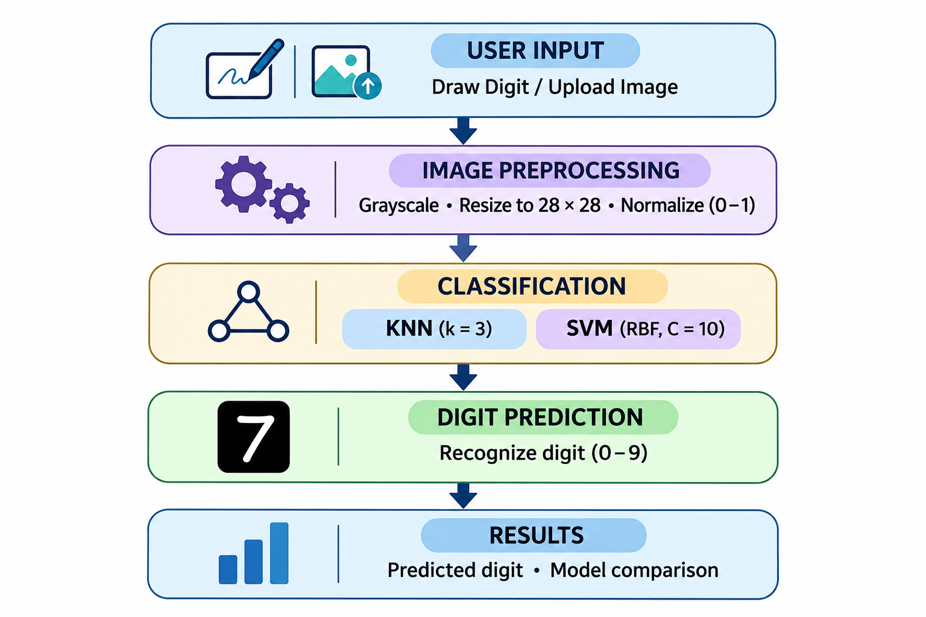
System Architecture
[Insert system architecture / block diagram
(Input → Processing → Output)]
Components
1
Input Module: Accepts handwritten digits through drawing or uploading.
2
Preprocessing Module: Converts input images into the required 28 × 28 format.
3
Classification Module: Uses KNN and SVM to recognize digits.
4
Output Module: Displays predictions, comparison and performance results.
Notes:
Insert a clear block diagram: input, processing, storage, output. Number each block and explain them on the right. Redraw the figure yourself rather than copying it.

Slide 7


Hardware & Software Requirements
Hardware
Software & Tools
Libraries / Frameworks
Intel i3 / equivalent processor
4 GB RAM or higher
2 GB free storage
Keyboard, mouse and display
Windows 10 / 11
Python 3.10+
VS Code / Jupyter Notebook
Git and GitHub
Scikit-learn – KNN and SVM algorithms
NumPy – Numerical processing
Streamlit – Web application
Matplotlib and Joblib
Deployment / Platform: Local Machine | Streamlit Web Application | MNIST Dataset
Notes:
List only what you actually used, with versions. For a pure software project, shorten the hardware list and add cloud or deployment resources.

Slide 8
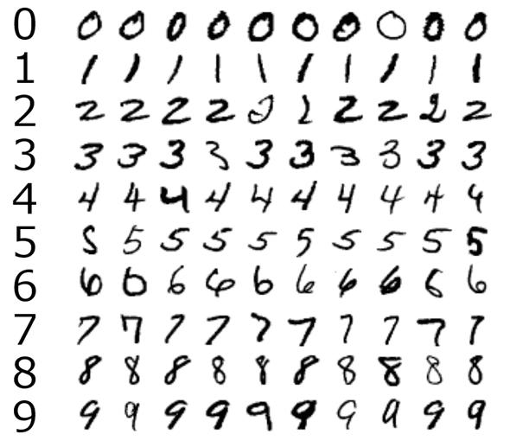
Dataset / Data Understanding
[Insert screenshot of the dataset
(head / info / sample records)]
[10,000]
[14]
Records (rows)
Features (columns)
[0]
[2]
Missing values
Target classes
Source: MNIST Handwritten Digit Dataset.
Features: 28 × 28 grayscale pixel values.
Quality: 60,000 training images and 10,000 testing images.
Notes:
Explain where the data came from and what it contains. Show a screenshot of the first rows or the info summary. For non-data projects, replace this slide with “Requirement Analysis” or “Input Specification”.

Slide 9
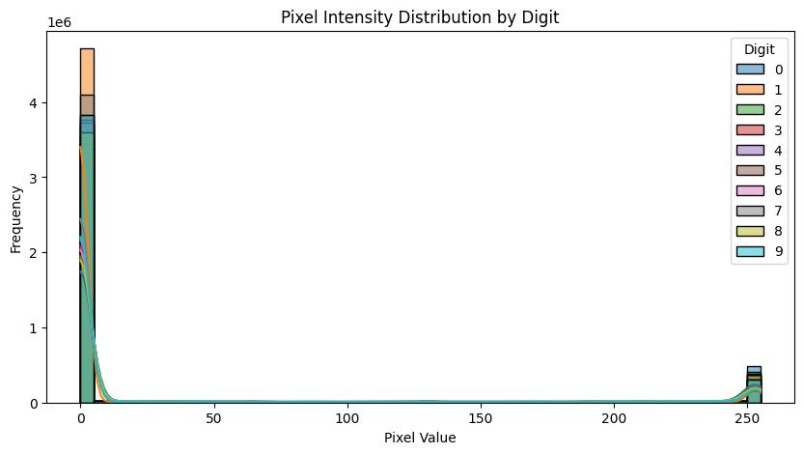
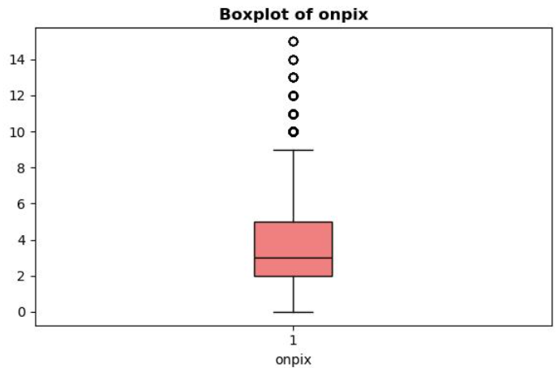



Data Preprocessing & Exploratory Analysis
[Insert feature distribution / histogram]
[Insert correlation heatmap / outlier box-plot]
Cleaning
Transformation
Feature Selection
Checked dataset quality.
No missing values in the MNIST dataset.
Converted images into grayscale format.
Resized images to 28 × 28 pixels.
Normalized pixel values between 0 and 1
Applied image centering and preprocessing.
Extracted 784 pixel features.
Each image contains 28 × 28 pixels.
All pixel features retained for classification.
Notes:
Show two or three plots that tell a story: distributions, correlations, outliers. Explain what each plot told you and what you did about it.

Slide 10
Module-wise Description
1
User Input Module
2
Image Preprocessing Module
Purpose: Allows users to draw or upload handwritten digits.
Input → Output: Digit image → Input image.
Developed by: Hasini
Purpose: Prepares images for accurate prediction.
Input → Output: Raw image → Processed 28×28 image.
Developed by: Greeshma
3
Machine Learning Classification Module
4
Prediction & Performance Analysis Module
Purpose: Recognizes handwritten digits using KNN and SVM algorithms.
Input → Output: Processed image → Predicted digit (0–9).
Developed by: Keerthi
Purpose: : Displays predictions and compares model performance.
Input → Output: Model predictions → Accuracy, graphs and comparison results.
Developed by: Hasini, Greeshma and keerthi
Notes:
Divide the project into three to five modules. For each, state its purpose, inputs, outputs and who built it. Duplicate a card if you have more modules.

Slide 11

Algorithms & Technologies Used
K-Nearest Neighbors (KNN)
Support Vector Machine (SVM)
Image Preprocessing & Normalization
Why chosen
Simple and effective classification algorithm.
Classifies digits based on nearest training images.
Key parameters
K = 3
Euclidean Distance
Majority Voting
Why chosen
Provides high classification accuracy.
Works effectively with complex digit patterns.
Key parameters
Kernel: RBF
C = 10
Decision Margin
Why chosen
Improves input image quality.
Ensures consistent image format for both models.
Key parameters
Image Size: 28 × 28
Pixel Normalization: 0–1
Selection criteria: Python | Scikit-learn | Streamlit | NumPy | Matplotlib | Pillow | Joblib | MNIST
Notes:
Name each model, algorithm or technology, say why you chose it, and list the key settings. Then explain how you picked the final one.

Slide 12
Implementation / Model Building
Feature Selection
Code snippet / pseudocode
Used 28 × 28 pixel images as input features.
Target labels represent digits from 0 to 9.
# Train KNN Model
knn = KNeighborsClassifier(n_neighbors=3)
knn.fit(X_train, y_train)
# Train SVM Model
svm = SVC(kernel='rbf', C=10)
svm.fit(X_train, y_train)
# Evaluate Models
knn_pred = knn.predict(X_test)
svm_pred = svm.predict(X_test)
Preprocessing Pipeline
Normalize pixel values between 0 and 1.
Resize images to 28 × 28 pixels.
Data Splitting
Dataset: MNIST, Training images: 60,000.esting images: 10,000.
Ten target classes (0–9).
Configuration
KNN: K = 3, Euclidean Distance, SVM: RBF Kernel, C = 10.
Evaluation metrics: Accuracy, Precision, Recall and F1-score.
]
Notes:
Describe the build in the order you did it. Paste only the most important code or pseudocode, not entire files. For hardware projects, show the circuit or wiring summary instead.

Slide 13
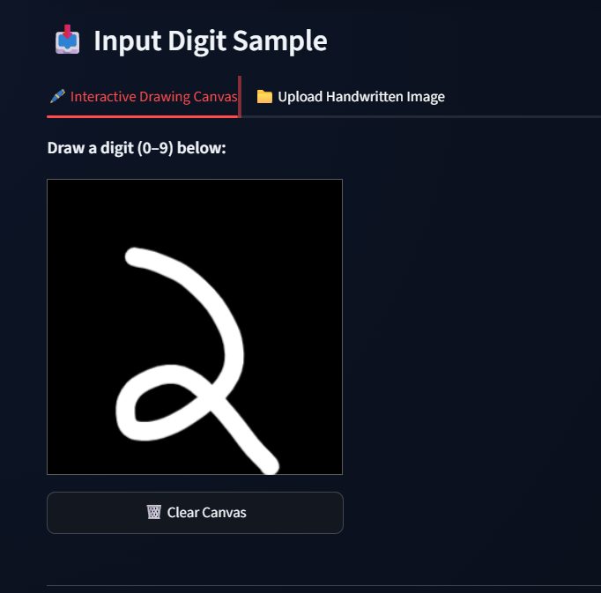
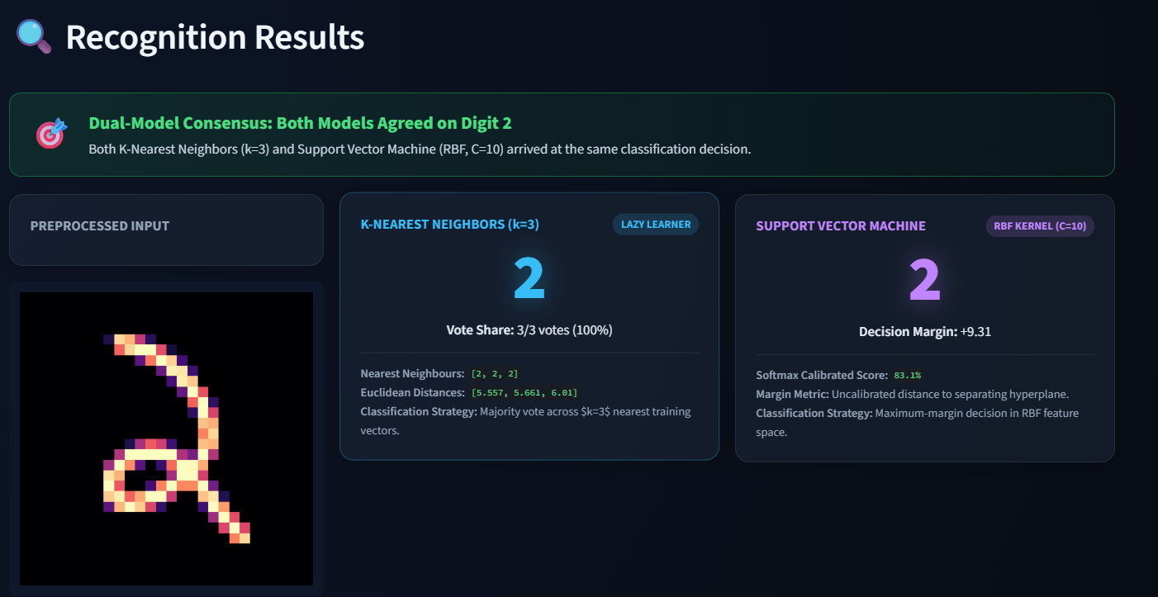
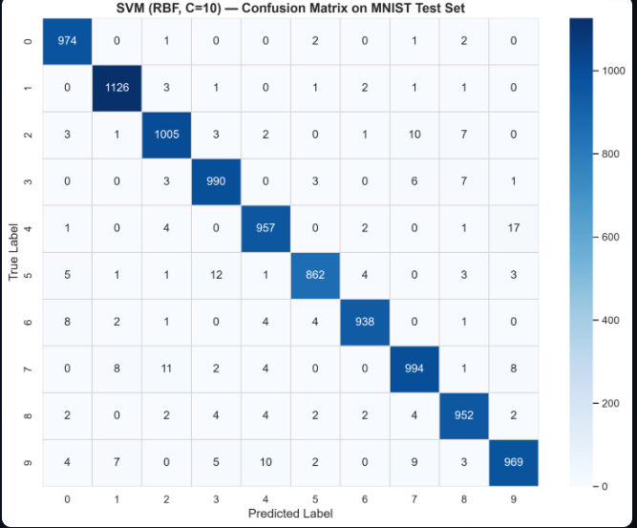
Working Prototype / Output Screens
[Screenshot / photo 1]
[Screenshot / photo 2]
[Screenshot / photo 3]
[Screen 1 title]
[One line: what it shows]
[Screen 2 title]
[One line: what it shows]
[Screen 3 title]
[One line: what it shows]
Notes:
Show real screenshots, photos of the hardware or a short demo video link. Caption each one with what the viewer should notice.

Slide 14
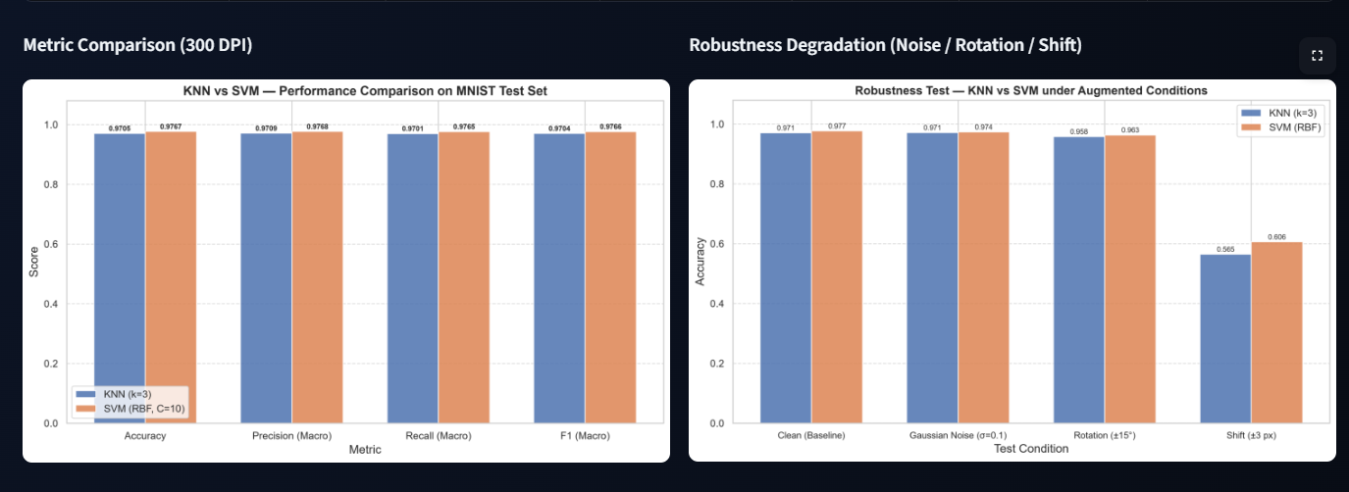
Results & Performance Comparison
Metric | Model A | Model B
Accuracy | 97.05% | 97.67%
Precision | 0.00 | 0.00
Recall | 0.00 | 0.00
F1-score | 0.00 | 0.00
ROC-AUC | 0.00 | 0.00
Best: [Model] – [metric = value]
Chart and table hold illustrative values only. Replace them with your own results.
Notes:
Right-click the chart and choose Edit Data to enter your real numbers. Replace the metrics with the ones that fit your project (accuracy, latency, power, throughput, user rating). State clearly which option performed best.

Slide 15
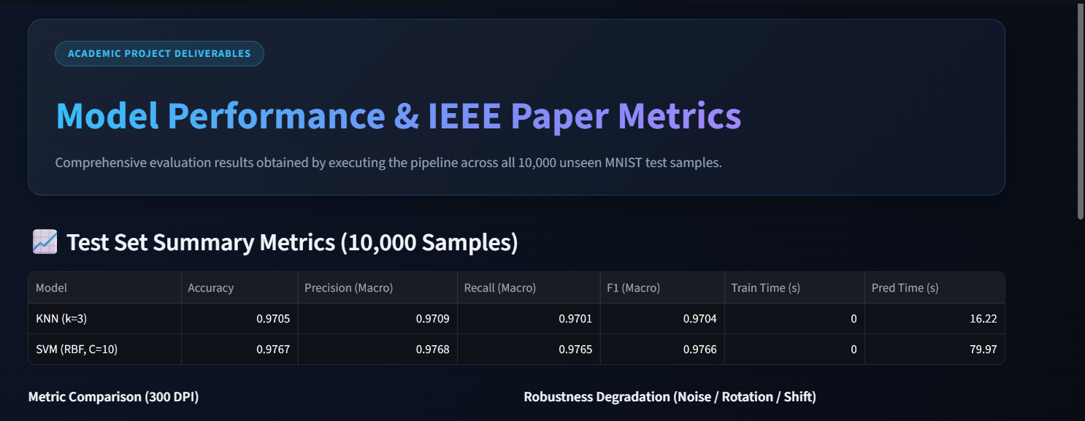
Analysis & Key Findings
[Insert confusion matrix / feature importance /
ROC curve / output comparison]
97.67%
Best Accuracy achieved by SVM
Interpretation: Both models achieved high accuracy, but SVM performed slightly better than KNN.
Error analysis: Misclassification mainly occurred between visually similar digits:
3 and 5
4 and 9
Key drivers: 28 × 28 pixel image representation.
Pixel normalization and image preprocessing.
Notes:
Explain what the numbers mean. Use a confusion matrix, ROC curve, feature-importance chart or output comparison. Be honest about weak results; panels value that.

Slide 16

Testing & Validation
Test ID | Test Description | Expected Result | Actual Result | Status
TC-01 | Draw a handwritten digit | Correct digit predicted | Digit predicted successfully | Pass
TC-02 | Upload a digit image | Recognize uploaded digit | Prediction displayed | Pass
TC-03 | KNN and SVM comparison | Both models generate predictions | Prediction Compared | Pass
TC-04 | Test using MNIST dataset | Achieve high classification accuracy | KNN: 97.05%, SVM: 97.67% | Pass
Functional Testing
Validation Method
Performance Testing
Tested handwritten digit drawing.
Tested image upload functionality.
Verified digit predictions using KNN and SVM.
Used the MNIST dataset.
Training samples: 60,000.
Testing samples: 10,000.
KNN Accuracy: 97.05%.
SVM Accuracy: 97.67%.
Compared prediction time and classification performance.
Notes:
List representative test cases with expected and actual outcomes. Name the validation methods you used. Delete rows you do not need.

Slide 17


Challenges & Limitations
Challenges Faced
Limitations
Handwriting variations: Different writing styles affected prediction accuracy → Improved image preprocessing and centering.
Image preprocessing: Uploaded images had different backgrounds and sizes → Applied grayscale conversion, cropping and resizing.
Model misclassification: Similar-looking digits caused incorrect predictions → Compared KNN and SVM to identify performance differences.
Dataset dependency: Models are trained using the MNIST dataset, which may not represent every real-world handwriting style.
Prediction errors: Unusual handwriting and unclear digits can lead to incorrect predictions.
Computational requirements: SVM training and prediction can take more time than KNN for certain workloads.
Notes:
Be candid. Pair every challenge with how you solved it, and list limitations that the panel would otherwise spot themselves.

Slide 18

Conclusion
Developed a Handwritten Digit Recognition system using Machine Learning to identify digits (0–9) from drawn or uploaded images using the MNIST dataset.
1
Final Outcome
97.67%
Trained and compared KNN and SVM models.
KNN achieved 97.05% accuracy.
SVM achieved 97.67% accuracy.
2
Best Accuracy – SVM (RBF)
Objectives achieved: 4/4
Successfully developed an interactive Streamlit application that allows users to draw or upload handwritten digits and view predictions with model comparison and performance analysis.
3
Notes:
Revisit each objective and say whether you met it. Quote your headline result with numbers. Do not introduce new material here.

Slide 19



Future Scope & Applications
Improve Performance
Explore advanced algorithms such as CNN and deep learning.
Improve recognition accuracy for complex handwriting.
Applications
Education: Automatic evaluation of handwritten answers and assignments.
Banking: Reading handwritten numerical entries on forms and cheques.
Digitalization: Converting handwritten notes into digital text.
Who would adopt it: Educational institutions, banks and document-processing organizations.
Expand Data / Features
Train using larger and more diverse handwriting datasets.
Support different handwriting styles and character types.
Deploy & Build an Interface
Develop a web and mobile application.
Provide real-time digit recognition and prediction.
Scale & Secure
Deploy the application on cloud platforms.
Improve data security and system reliability.
Notes:
Give concrete next steps, ideally tied to the limitations. Then name two or three real-world uses.

Slide 20
Team Contribution
Reg. No. | Name | Contribution / Modules Handled
2420030784 | Hasini | User Input Module, Prediction Dashboard, Model Comparison and PPT preparation
2420030550 | Greeshma | Image Preprocessing, Image Resizing, Normalization and Data Preparation
2420030550 | Keerthi | KNN & SVM Model Implementation, Training, Testing and Evaluation
Notes:
Show that work was planned and shared. Every member should be able to explain their own module.

Slide 21

References
[1] C. Zhang, C. Tu, Z. Wang, W. Cao, and W. Cao, “ResNet18-ThunderSVM: Hybrid Intelligence for Handwritten Digit Recognition by Fusing Deep Spatial Features and High-Performance Classification,” Scientific Reports, vol. 16, article 7701, 2026. DOI: 10.1038/s41598-026-38258-4.
[2] L. Guo and Z. Wang, “Task-fMRI-Derived Number-Related Functional Brain Topology Constrained Spiking Neural Networks for Handwritten Digit Recognition,” Applied Sciences, vol. 16, no. 12, article 6207, 2026. DOI: 10.3390/app16126207.
[3] R. Sethi and V. Pareek, “Optical Handwritten Digit Recognition Using Deep Learning Models on the MNIST Dataset,” 2026 9th International Conference on Inventive Computation Technologies (ICICT), 2026. DOI: 10.1109/ICICT68280.2026.11511159
[4] D. Zhao, C. Yang, Z. Hu, S. Yuan, and X. Zhou, “Handwritten Digit Recognition Based on Ghost Imaging and Cake-Cutting Hadamard Matrix,” Physics Letters A, vol. 577, article 131459, 2026. DOI: 10.1016/j.physleta.2026.131459.
Project Links
GitHub: [URL]
Dataset: [URL]
Demo video: [URL]
Notes:
Use IEEE style, numbered in order of first citation in the deck. Include datasets, documentation and code repositories.

Slide 22
THANK YOU
Questions & Discussion
[Team email / contact details]
[Guide name and department]
Notes:
Leave this slide up during questions. Make sure every team member can answer questions about their own module.

